Slide 1
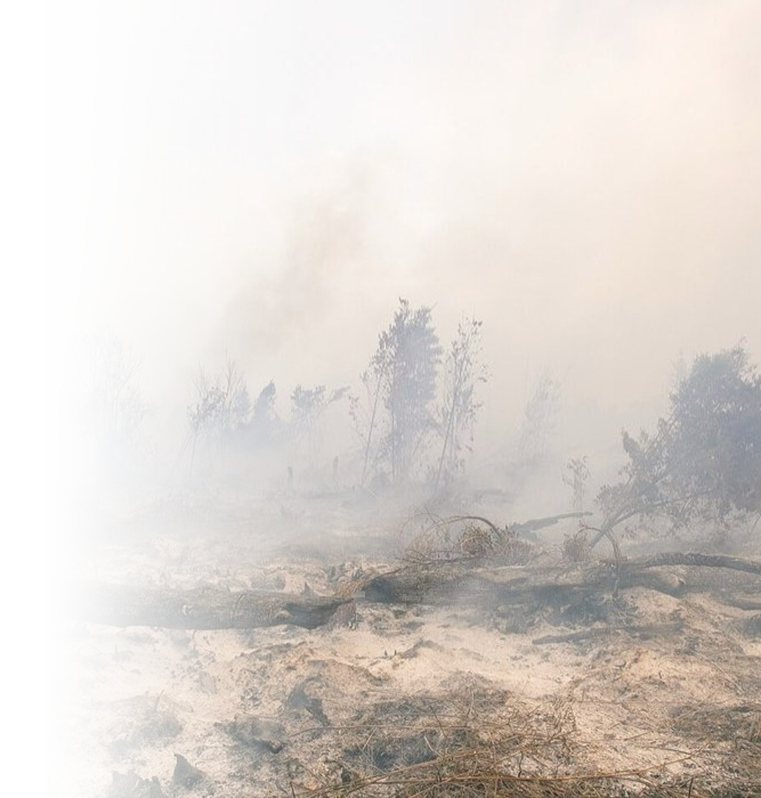



Public Narrative
Brief: Forest and
Land Fires 2026
Shared Homework for the Nation in 2026
PRESENTED BY
Lieutenant General TNI Kristomei Sianturi, S.Sos., M.Si. (Han)
Head of the National Disaster Management Agency (BNPB)
Jakarta, 4 November 2026
© 2026 Badan Nasional Penanggulangan Bencana
A Resilient Nation Facing Disasters
Photo: DenY Krisbiyantoro, CC BY-SA 4.0, Wikimedia Commons

Slide 2
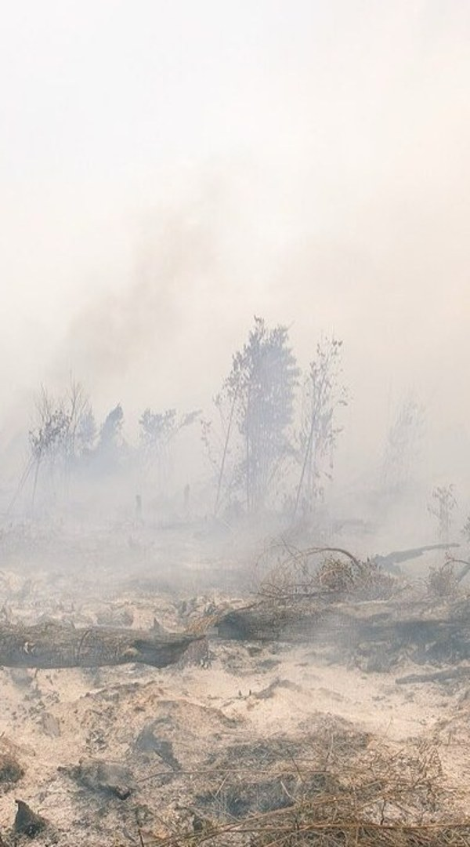
01
Scale of the 2026 Season
4–6
02
Peatland and Oil Palm
Contents
7–9
03
Law Enforcement
10–12
Public Narrative Brief: Forest and Land Fires 2026
04
National Strength
13–14
05
International Assistance and Sovereignty
15–26
2

Slide 3













Firespots in 2026 reach 1.7 times 2019; Indonesia has deployed 53,828
personnel and 64 aircraft
SEASON SCALE
NATIONAL STRENGTH
812,271
32.4%
32.6%
53,828
2,441
firespots this year
in Central Kalimantan
in peatland areas
firefighting personnel
water bombing sorties
Key message
The Government of Indonesia leads the 2026 response to forest and land fires and concentrates it on peatland areas. Individuals and corporations that deliberately burn land are pursued; foreign assistance is coordinated under government command.
Firespots in 2026 reach 1.7 times 2019 and 76% of 2015.
One third of the points lie in peatland areas; dry peat makes fires hard to extinguish, so the response is concentrated on peatland.
Bareskrim Polri has named 20 corporations and 245 individuals as suspects in 2026 forest and land fire cases.
The response is a joint effort: 31,928 personnel from government units (TNI, Polri, BPBD, local government, Manggala Agni, Forest Police) and 21,900 from community groups (company crews, volunteers, Fire Care Community).
MESSAGES FOR THE PUBLIC
Scale of the 2026 season
Focus on peatland areas
Single-channel assistance
The 2026 season is the most severe since 2019 and is handled under national command.
Prevention and response are concentrated on dry peatland areas.
Foreign assistance enters through one BNPB channel under Indonesian government command.
Source: Processed by BNPB from NASA FIRMS, 1 Jan–2 Nov; KHG to 24 Oct; Setkab; Bareskrim Polri; Bakom 15 Oct
© 2026 Badan Nasional Penanggulangan Bencana
3

Slide 4
01
Scale of the 2026 Season
4–6
01
02
Peatland and Oil Palm
7–9
03
Law Enforcement
Scale of the 2026 Season
10–12
04
National Strength
13–14
05
International Assistance and Sovereignty
15–26
4

Slide 5



01 Season scale
02 Peatland and oil palm
03 Law enforcement
04 National strength
05 Assistance and sovereignty
Firespots in 2026 reach 1.7 times 2019 and 4.7 times 2023, still below 2015
THIS YEAR
812,271
firespots this year
National firespots
Weekly trend
Firespots, January to end of October
Firespots per week
400,378
97,532
304,643
77,057
70,772
70,192
60,607
179,208
14,765
65,362
28 Sep
5 Oct
12 Oct
19 Oct
26 Oct
2 Nov
27.1%
26.6%
27.4%
0.8%
79.0%
2015
2019
2023
2026
Peak in early October; the rainy season is starting to reduce firespot numbers.
MESSAGES FOR THE PUBLIC
Scale of the 2026 season
Starting to ease
Kalimantan
Highest firespot count since 2019, still below 2015.
Latest-week firespots, down 84.9% from the peak week; the trend continues to be monitored.
The five Kalimantan provinces account for 55.5% of national firespots this year.
Source: Processed by BNPB from NASA FIRMS VIIRS; firespot classification; 1 Jan–27 Oct each year, weeks to 2 Nov
© 2026 Badan Nasional Penanggulangan Bencana
5

Slide 6



01 Season scale
02 Peatland and oil palm
03 Law enforcement
04 National strength
05 Assistance and sovereignty
Firespot Distribution by Province
DISTRIBUTION
87.1%
55.5%
of firespots are in the top ten provinces
of firespots are in the four Kalimantan provinces
Firespots by province
Firespots by month, 2026
PROVINCE
FIRESPOTS 2026
NATIONAL SHARE
Firespots per month
Central Kalimantan
263,483
32.4%
294,699
308,073
West Kalimantan
110,564
13.6%
South Papua
106,676
13.1%
South Sumatra
71,949
8.9%
166,172
East Kalimantan
40,313
5.0%
South Kalimantan
36,809
4.5%
Maluku
29,145
3.6%
West Papua
23,540
2.9%
3,909
19,567
3,223
Central Sulawesi
13,095
1.6%
Jun
Jul
Aug
Sep
Oct
Nov*
North Maluku
12,303
1.5%
Other provinces
104,394
12.9%
94.7% of this year's firespots occurred between August and October.
*Current month; data to 2 November.
Total
812,271
Source: Processed by BNPB from NASA FIRMS VIIRS, firespot classification, 1 Jan–2 Nov
© 2026 Badan Nasional Penanggulangan Bencana
6

Slide 7
01
Scale of the 2026 Season
4–6
02
02
Peatland and Oil Palm
7–9
03
Law Enforcement
Peatland and Oil Palm
10–12
04
National Strength
13–14
05
International Assistance and Sovereignty
15–26
7

Slide 8



01 Season scale
02 Peatland and oil palm
03 Law enforcement
04 National strength
05 Assistance and sovereignty
Forest and land fire area surges in a long dry year (El Nino)
LOSSES
PEATLAND
about 15
32.6%
439,785
billion US dollars, projected 2026 losses
of 2026 hotspots in peatland areas
hotspots in peatland areas
Official national burned area
Peatland
Burned area, ha per year, 2015–2026
Peat embers spread beneath the surface, so fires are hard to put out from above.
Peatland is considered degraded when its water table drops more than 40 cm below the surface; at that point peat is dry and burns easily.
The number of forest and land fire incidents rises sharply when average rainfall during the dry season is below 4 mm/day.
The 2015 losses were about US$6,165 per ha, with losses of US$16.1 billion (World Bank); this figure is the basis of the 2026 projection.
2.6 million
2.5 million
1.6 million
1.2 million
438,363
529,267
358,864
376,806
359,619
165,484
296,943
205,000
2015
2016
2017
2018
2019
2020
2021
2022
2023
2024
2025
2026*
POINTS CONVEYED
Dry peat
Area in 2026
Peatland areas
Peat left to dry out burns easily; the fire spreads beneath the surface and the smoke travels far.
The 2026 bar is a satellite-based projection to 3 November; the official area follows once the season ends.
Indonesia has 865 peatland areas covering 24.7 million ha.
Source: SiPongi via Bakom 15 Oct; BNPB; KLHK KHG map; World Bank 2016; ACP 2018
© 2026 Badan Nasional Penanggulangan Bencana
8

Slide 9





01 Season scale
02 Peatland and oil palm
03 Law enforcement
04 National strength
05 Assistance and sovereignty
In the October peak week, 26.2% of hotspots were inside concessions; most in
industrial timber, then oil palm
INSIDE CONCESSIONS
48,035
20
23
hotspots in concession areas
corporate suspects
corporations proposed for licence revocation
Hotspots in concession areas by licence type
Narrative
Hotspots, peak week of October
Licence holders must prevent and extinguish fires in their areas.
Hotspots in concession areas are the basis for investigation by Forestry law enforcement and Bareskrim Polri.
Industrial timber plantations account for the most concession hotspots; oil palm plantations come second.
Oil palm is a strategic commodity; action is taken against individuals who burn, especially on peatland.
Industrial timber plantations
20,181
Oil palm plantations
16,214
Natural forest (HPH)
13,697
Mining
1,007
SUPPORTING FACTS
Water table for everyone
Licences revoked
Foreign capital
The duty to maintain peatland water levels applies to all land managers.
The Ministry of Forestry has revoked 5 licences of companies whose areas burned.
4 suspect corporations have foreign capital and face the same law as domestic ones.
Source: Processed by BNPB from NASA FIRMS VIIRS and the concession map (GFW, Trase), 6–12 Oct
© 2026 Badan Nasional Penanggulangan Bencana
9

Slide 10
01
Scale of the 2026 Season
4–6
03
02
Peatland and Oil Palm
7–9
03
Law Enforcement
Law Enforcement
10–12
04
National Strength
13–14
05
International Assistance and Sovereignty
15–26
10

Slide 11

01 Season scale
02 Peatland and oil palm
03 Law enforcement
04 National strength
05 Assistance and sovereignty
Data show that land burned and then planted sells for US$3,800 per ha, 5.7 times
land cleared by felling only
Land sale price, US$ per ha
2026 law enforcement
+2,944
3,800
STAGE
TOTAL
Individual suspects (people)
245
Administrative sanctions (legal entities)
26
Proposed for licence revocation (corporations)
23
Corporate suspects (corporations)
20
Licences already revoked (licences)
5
Bareskrim Polri proposes licence revocation to the licensing ministries.
The Ministry of Forestry freezes other licences and requires land restoration.
Burners are prosecuted as individuals; their financiers are charged as corporations.
Companies that helped extinguish fires are still charged if their land is proven to have been burned.
Law enforcement removes the economic gain from burning land.
+191
665
Land cleared by felling
Additional if burned
Additional if planted
Burned then planted
LEGAL ACTION
Burners
Financiers
Land
Individual criminal charges for those paid to set fires.
Corporations that fund burning are pursued whoever owns them.
Land that is deliberately burned may not become a new plantation; the licence is revoked.
Source: Purnomo et al. 2017; Bareskrim Polri 29 Oct; Kemenhut law enforcement 18 Oct
© 2026 Badan Nasional Penanggulangan Bencana
11

Slide 12
01 Season scale
02 Peatland and oil palm
03 Law enforcement
04 National strength
05 Assistance and sovereignty
Responsibility for the fires extends beyond Indonesia: 83 of 103 companies with
hotspots in their concessions belong to groups with foreign shareholders
FOREIGN AFFILIATION
65
18
4
Singapore-group companies
Malaysia-group companies
foreign corporations named suspects
Foreign business groups with the most hotspots in their areas
Narrative
BUSINESS GROUP
COUNTRY OF ORIGIN
COMPANIES
HOTSPOTS
Most companies in hotspot areas are affiliated with Singapore and Malaysia business groups.
The same legal treatment applies to companies with foreign capital and to companies with domestic capital.
Hotspots in licensed areas indicate locations; perpetrators are determined through investigation.
Sinar Mas
Singapore
25
9,264
RGE/APRIL
Singapore
6
3,599
Wilmar
Singapore
21
1,388
Premier Palmoil Energy Pte Ltd
Singapore
1
339
Musim Mas
Singapore
4
152
Sime Darby
Malaysia
7
129
Sampoerna Agro/POSCO
Singapore, South Korea
1
68
First Resources
Singapore
2
63
8 other groups
Singapore, Malaysia
16
48
Total
83
15,050
Source: WALHI 2026 actor map study; Processed by BNPB from NASA FIRMS VIIRS and the licence map, 5–12 Oct; Bareskrim Polri 29 Oct
© 2026 Badan Nasional Penanggulangan Bencana
12

Slide 13
01
Scale of the 2026 Season
4–6
04
02
Peatland and Oil Palm
7–9
03
Law Enforcement
National Strength
10–12
04
National Strength
13–14
05
International Assistance and Sovereignty
15–26
13

Slide 14








01 Season scale
02 Peatland and oil palm
03 Law enforcement
04 National strength
05 Assistance and sovereignty
Fire suppression in 2026 involves 53,828 personnel; 64 aircraft serve patrols,
weather modification (OMC) and water bombing
Firefighting personnel by unit: government and community
Air fleet
Air fleet
64
12,285
8,594
3,472
helicopters and aircraft deployed
TNI, 22.8%
Polri, 16.0%
BPBD, 6.5%
Water bombing
water drops by helicopter in 2,441 sorties
81,502
4,767
1,376
1,434
Local government, 8.9%
Manggala Agni, 2.6%
Forest Police, 2.7%
Air patrols
1,233
fire monitoring sorties
OMC
97
8,950
8,201
4,749
weather modification sorties
Companies, 16.6%
Volunteers, 15.2%
Fire Care Community (MPA), 8.8%
Source: Bakom 15 Oct 2026; Setkab 21 Sep 2026; BNPB air ops recap to 25 Oct
© 2026 Badan Nasional Penanggulangan Bencana
14

Slide 15
01
Scale of the 2026 Season
4–6
05
02
Peatland and Oil Palm
7–9
03
Law Enforcement
International Assistance and Sovereignty
10–12
04
National Strength
13–14
05
International Assistance and Sovereignty
15–26
15

Slide 16


01 Season scale
02 Peatland and oil palm
03 Law enforcement
04 National strength
05 Assistance and sovereignty
Foreign assistance needs careful handling to avoid gaps that could affect
Indonesia's sovereignty
Gaps that could be exploited and how to close them
WHAT OTHER COUNTRIES CAN MAP
HOW THE GOVERNMENT CLOSES THE GAPS
Response
How quickly Indonesia moves when a major disaster occurs
Command stays with BNPB; foreign teams only assist
Territory
Hotspot distribution and logistics routes in vulnerable areas
Every flight by another country requires a permit and follows its assigned task
Concessions
Concession areas and oversight in border regions
Foreign teams enter only the assigned site and are always accompanied by officials
Data
Strength of data centres and the national logistics chain
Imagery and operational data are handed to the government and processed domestically
Opinion
Extent of public concern over smoke
The government speaks with one voice, with open official data
Funding
Foreign fund flows to domestic institutions
Foreign institutions and funds must register and coordinate with BNPB
Source: Law 24/2007; GR 23/2008; GR 4/2018; GR 45/2021
© 2026 Badan Nasional Penanggulangan Bencana
16

Slide 17

01 Season scale
02 Peatland and oil palm
03 Law enforcement
04 National strength
05 Assistance and sovereignty
Overseas partnership: assistance is welcomed with appreciation, and operational
sovereignty comes first
Basic principles and key sentences
Basic principles
Key sentences
Humanitarian assistance from abroad is welcomed with appreciation and handled with care.
We are open to partnerships that are equal and mutually respectful.
Operational sovereignty rests with BNPB in accordance with Indonesian law.
Assistance operations can be used to gauge response capacity and map territory.
This is a mandate of the law and is not negotiable.
National interest and operational sovereignty are the first priority.
All assistance works under the command of the Government of Indonesia.
Partnerships with friendly countries continue on an equal footing.
Source: BNPB foreign partnership guide, Nov 2026; Law 24/2007
© 2026 Badan Nasional Penanggulangan Bencana
17

Slide 18

01 Season scale
02 Peatland and oil palm
03 Law enforcement
04 National strength
05 Assistance and sovereignty
Ten recommendations for overseas partnership guidelines (1/2)
STEP
DETAIL
STAKEHOLDER
Affirm BNPB as the single coordinator
BNPB leads coordination under the Disaster Management Law; other countries act as supporters.
BNPB
Kemenko PMK
Apply a single-channel policy
Water bombing aircraft, logistics, funds and personnel are recorded through BNPB; direct channels to regional governments or NGOs are avoided.
BNPB
Kemensetneg
Ministry of Finance
Accept assistance in a balanced way
Assistance from the United States and China as well as Japan, Malaysia, Australia and Singapore is accepted together so that none becomes dominant.
Kemlu
BNPB
Request lists of personnel and equipment
Names, identities, equipment, sensors, drones, radio frequencies and flight routes are submitted before operations begin.
BNPB
TNI
Kemlu
Require accompaniment by Indonesian personnel
Every team from another country is accompanied by BNPB or TNI personnel in the field, including an official interpreter.
BNPB
TNI
Source: Law 24/2007; GR 23/2008; GR 4/2018; BNPB foreign partnership guide, Nov 2026
© 2026 Badan Nasional Penanggulangan Bencana
18

Slide 19
01 Season scale
02 Peatland and oil palm
03 Law enforcement
04 National strength
05 Assistance and sovereignty
Ten recommendations for overseas partnership guidelines (2/2)
STEP
DETAIL
STAKEHOLDER
Set limits on areas of access
Papua and border regions, including sensitive concession areas, may be entered only with written permission from the competent authority or the Head of BNPB.
BNPB
TNI
Ministry of Forestry
Prioritise local products and services
Assistance uses local logistics, food, fuel and labour to support the domestic economy.
BNPB
Ministry of Industry
Control public communication
Media releases through BNPB and the Intermestic forum highlight national capacity; weaknesses in logistics and data systems are not discussed with other countries.
BNPB
Government Communications Agency
Promote technology transfer and time limits
Assistance comes with training for Indonesian personnel and agreed start and end dates.
BNPB
Kemlu
Involve other ministries and report to leadership
Foreign data is checked before it leaves Indonesia; results are reported to the President through the Coordinating Minister, with no new bilateral commitments before central approval.
BNPB
Kemenko PMK
Kemlu
Source: Law 24/2007; GR 23/2008; GR 4/2018; BNPB foreign partnership guide, Nov 2026
© 2026 Badan Nasional Penanggulangan Bencana
19

Slide 20

01 Season scale
02 Peatland and oil palm
03 Law enforcement
04 National strength
05 Assistance and sovereignty
Limits that must not be crossed when accepting foreign assistance
What cannot be permitted
NOT PERMITTED
PROVISIONS
Flights
Aircraft of other countries fly freely to map territory
Flight plans must be approved by BNPB and the Air Force
Data
Real-time hotspot data and concession maps handed to outside parties
TNI strength data and public sentiment stay within the country
Bases
Own base camp or warehouse outside BNPB posts
All teams work from the BNPB command post
Conditions
Assistance conditional on access to new mines or concessions
Assistance accepted without political or economic conditions
Funding
Assistance funds managed directly by foreign NGOs
Funds managed through government mechanisms
Sensors
Drones or thermal and LIDAR sensors without permission
Only with permits and official escort
Agreements
Verbal commitments or signatures during an audience
Written, reviewed at least seven days by Foreign and Defence Ministries
Interviews
Interviews with victims without an escort
Accompanied by official authorities or BNPB
Military
Armed teams or projects in sensitive areas
Approval of President and TNI HQ; Papua, South China Sea closed
Access
Permanent assistance hubs or joint bases
Not approved; avoid the image of a weak Indonesia
Source: BNPB foreign partnership guide, Nov 2026
© 2026 Badan Nasional Penanggulangan Bencana
20

Slide 21
01 Season scale
02 Peatland and oil palm
03 Law enforcement
04 National strength
05 Assistance and sovereignty
Humanitarian operations use civil MoUs under BNPB; SOFA and VFA are matters
for the central government
Guide to three types of documents
Key sentences if offered a SOFA
MoU
SOFA
VFA
We greatly appreciate the offer of assistance.
For humanitarian operations, we use civil mechanisms under BNPB in accordance with the Disaster Management Law.
Agreements on the status of forces are the authority of the central government through the Foreign and Defence Ministries, and are not decided in a disaster management partnership forum.
The offer of assistance continues to be processed through BNPB's civil mechanisms.
Memorandum of Understanding: a civil cooperation memorandum, without military immunity.
Status of Forces Agreement: an agreement between states on the legal status of foreign military personnel while in Indonesia.
Visiting Forces Agreement: an agreement on visits by foreign forces for temporary military exercises, similar to a SOFA.
Signed by BNPB with partner institutions.
Decided by the central government through the Foreign and Defence Ministries.
Concerns jurisdiction and sovereignty.
The mechanism BNPB uses.
Not signed at BNPB level.
Not within BNPB's authority.
Source: Law 24/2007; BNPB foreign partnership guide, Nov 2026
© 2026 Badan Nasional Penanggulangan Bencana
21

Slide 22


01 Season scale
02 Peatland and oil palm
03 Law enforcement
04 National strength
05 Assistance and sovereignty
Australia supports the East Kalimantan operation with 1 Hercules aircraft, 6
sorties a day for 7 days
OPERATION PLAN
1
6
7
42
Hercules aircraft
sorties per day
operation days
sorties planned
Australian assistance narrative
Thanks to a friendly nation
Three-party collaboration
In line with the diplomatic note
Supporting government operations
The government appreciates assistance from friendly countries, including Australia.
The operation is run by BNPB together with Australia.
The operation follows the offer in the diplomatic note of the Government of Australia.
Australia's presence complements the government operation already under way in East Kalimantan.
The East Kalimantan Provincial Government takes part in the operation.
This assistance is a good form of bilateral cooperation.
The operation is scheduled for early November.
Command remains with BNPB.
OPERATIONAL ARRANGEMENTS
Accompaniment
Flight plan
Reporting
Crews and aircraft are accompanied by BNPB and TNI personnel throughout the operation.
Every sortie uses a flight plan approved by BNPB and the Air Force.
Operation results are reported daily to the BNPB command post.
Source: Australian diplomatic note, operation plan 6–12 Nov 2026
© 2026 Badan Nasional Penanggulangan Bencana
22

Slide 23
01 Season scale
02 Peatland and oil palm
03 Law enforcement
04 National strength
05 Assistance and sovereignty
Talking Point: Welcoming Australian Assistance for Forest and Land Fire
Response in East Kalimantan (1/3)
Halim Perdanakusuma Air Base, Jakarta
Appreciation and Solidarity
Assistance as Support to an Indonesian-Led Response
On behalf of the Government and people of Indonesia, I wish to convey our heartfelt appreciation to the Government and people of Australia for the timely and generous offer of assistance in response to the forest and land fires currently affecting our country. This gesture of solidarity speaks volumes about the depth of friendship, mutual trust, and good neighbourliness that has long characterised the relationship between Indonesia and Australia, particularly in times of adversity.
We are deeply grateful for this support, and we would like to respectfully underline that assistance from Australia, as well as from other partner countries, is most welcome as a complement to the response operations led and conducted by the Government of the Republic of Indonesia. This approach ensures coherence, accountability, and effectiveness on the ground, while allowing us to make the best possible use of the valuable contributions of our partners.
KEY MESSAGES
Appreciation
Indonesian-led
Well targeted
Thanks to the government and people of Australia for the prompt offer of assistance.
Partner assistance complements operations led by the Government of Indonesia.
Assistance is put to the best use according to field needs.
Source: Head of BNPB talking points, Nov 2026; Bakom 15 Oct 2026; Setkab 21 Sep 2026
© 2026 Badan Nasional Penanggulangan Bencana
23

Slide 24
01 Season scale
02 Peatland and oil palm
03 Law enforcement
04 National strength
05 Assistance and sovereignty
Talking Point: Welcoming Australian Assistance for Forest and Land Fire
Response in East Kalimantan (2/3)
Halim Perdanakusuma Air Base, Jakarta
BNPB as Coordinating Authority within a Single Command System
Focused and Complementary Operational Support
In accordance with the Law on Disaster Management of 2007, operational coordination for disaster response in Indonesia rests with the National Disaster Management Authority, BNPB. Accordingly, all personnel, aircraft, equipment, and logistics from partner countries will be fully integrated into our national command system, accompanied at all times by BNPB and Indonesian National Armed Forces personnel, and will operate on the basis of flight plans and operational plans approved by BNPB and the Air Force. This arrangement is intended to ensure safety, coordination, and the optimal use of all available resources.
We are pleased that Australian assistance will complement our ongoing national efforts, particularly in strengthening aerial water-bombing operations. To date, our helicopters have flown 2,441 water-bombing sorties and released water 81,502 times, supported by 97 weather modification sorties. These contributions will add significant value to our integrated operations, which also include ground firefighting, weather modification, and joint patrols, and will help accelerate our collective progress on the ground.
KEY MESSAGES
Single command
Flight plan
Water bombing
All partner assets enter the national command system under BNPB.
Flights use plans approved by BNPB and the Air Force.
Assistance strengthens the air operations already under way.
Source: Head of BNPB talking points, Nov 2026; Bakom 15 Oct 2026; Setkab 21 Sep 2026
© 2026 Badan Nasional Penanggulangan Bencana
24

Slide 25
01 Season scale
02 Peatland and oil palm
03 Law enforcement
04 National strength
05 Assistance and sovereignty
Talking Point: Welcoming Australian Assistance for Forest and Land Fire
Response in East Kalimantan (3/3)
Halim Perdanakusuma Air Base, Jakarta
Indonesia's National Commitment
Current Situation and Continued Priorities
Moving Forward
I would like to share with Your Excellency the scale of Indonesia's national response. To date, the Government has mobilised 53,828 joint personnel and 64 aircraft across Sumatra, Kalimantan, and Papua, from the Armed Forces and the Police to local governments, private-sector crews, volunteers, and community fire brigades. This mobilisation reflects the full commitment of the Government of Indonesia to addressing this challenge with all available national capacities, and with the strong support of our partners. Around 40.7% of these personnel come from communities and the private sector, reflecting a truly whole-of-society effort.
While air quality in several affected areas has begun to show encouraging signs of improvement, we remain fully vigilant. Weekly fire detections have fallen by 84.9% from their peak in early October as the rainy season begins. Fire suppression and the prevention of further spread continue to be our foremost priorities. The Government of Indonesia remains firmly committed to managing this situation in a swift, measured, and transparent manner, while placing the safety of our communities and the preservation of our national sovereignty at the centre of all our efforts.
Over the coming days, the Australian Hercules will fly 6 sorties a day for 7 days in East Kalimantan, working side by side with our national fleet and the Provincial Government of East Kalimantan under a single command. In closing, we express our sincere hope that this cooperation will extend well and deepen our partnership. We are confident that through continued collaboration, we can further strengthen the resilience of both our peoples and the wider region.
KEY MESSAGES
National commitment
Remaining vigilant
Continuing partnership
The government mobilises all national capacity.
Suppression and preventing the fire from spreading remain the priority.
The cooperation is expected to strengthen regional resilience.
Source: Head of BNPB talking points, Nov 2026; Bakom 15 Oct 2026; Setkab 21 Sep 2026
© 2026 Badan Nasional Penanggulangan Bencana
25

Slide 26


01 Season scale
02 Peatland and oil palm
03 Law enforcement
04 National strength
05 Assistance and sovereignty
Conclusions
Scale
Trend
Response
Aggravating factor
Most severe season since 2019
Starting to ease
National command
Dry peat
Latest-week firespots, down 84.9% from the peak week.
The rainy season is starting to suppress fires; the trend continues to be monitored.
53,828 government and community personnel.
64 helicopters and aircraft under a single command.
One third of hotspots are in peatland areas.
Peat that dries out burns easily and is hard to extinguish.
Firespots in 2026 reach 1.7 times 2019.
Still below the major fires of 2015.
Oil palm
Perpetrators
Assistance
Together
Strategic commodity
The chain of burners
Single-channel assistance
Working together
26.2% of peak-week hotspots are in concession areas.
Licence holders must prevent and extinguish fires.
20 corporations and 245 individuals are suspects.
Burners and their financiers are pursued.
Foreign assistance enters through BNPB coordination.
Foreign teams work under the command of the Government of Indonesia.
40.7% of personnel come from community groups.
Government and community work under one command.
Source: Processed by BNPB from NASA FIRMS; Setkab; Bareskrim Polri; Bakom 15 Oct
© 2026 Badan Nasional Penanggulangan Bencana
26

Slide 27
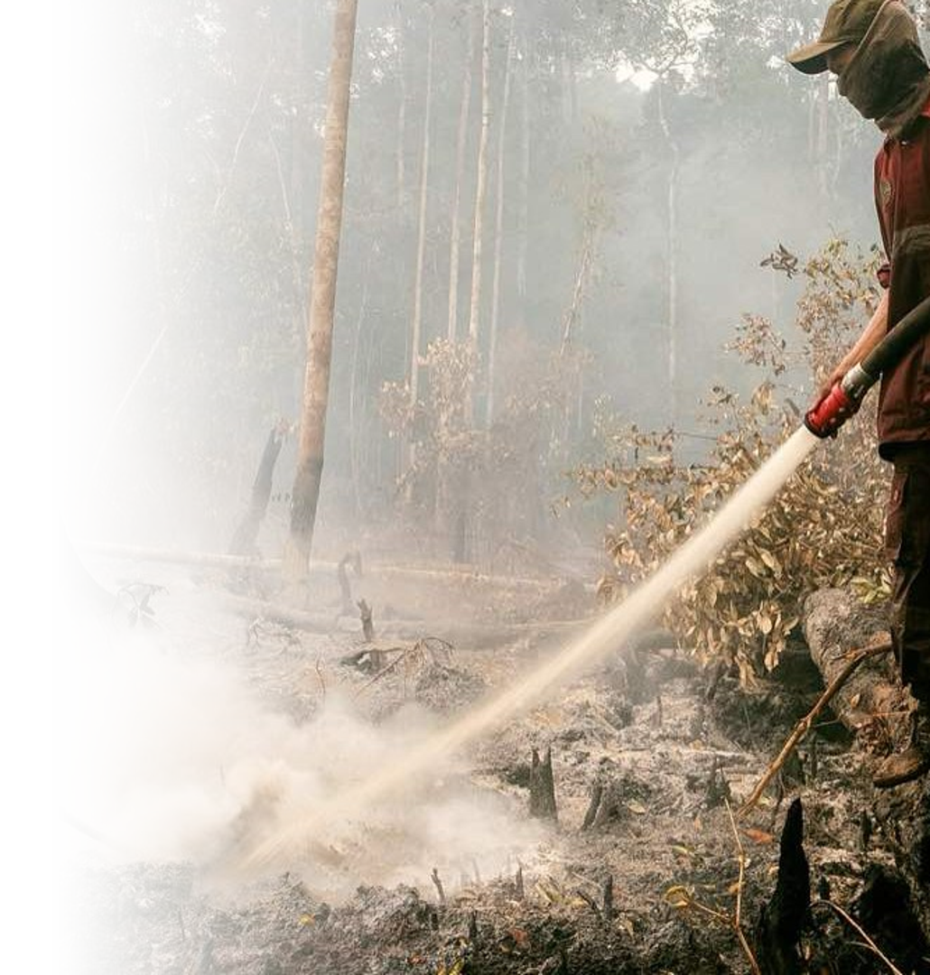









Thank You
Lieutenant General TNI Kristomei Sianturi, S.Sos., M.Si. (Han)
Head of the National Disaster Management Agency (BNPB)
BADAN NASIONAL PENANGGULANGAN BENCANA
CALL CENTER
Graha BNPB, Jl. Pramuka Kav. 38, Jakarta Timur 13120
117
021 2982 7793
persuratan@bnpb.go.id
www.bnpb.go.id
Satu Data Bencana
@BNPB_Indonesia
@infoBencanaBNPB
BNPB Indonesia
@bnpbindonesia
© 2026 Badan Nasional Penanggulangan Bencana
A Resilient Nation Facing Disasters
Photo: DenY Krisbiyantoro, CC BY-SA 4.0, Wikimedia Commons

